Slide 1
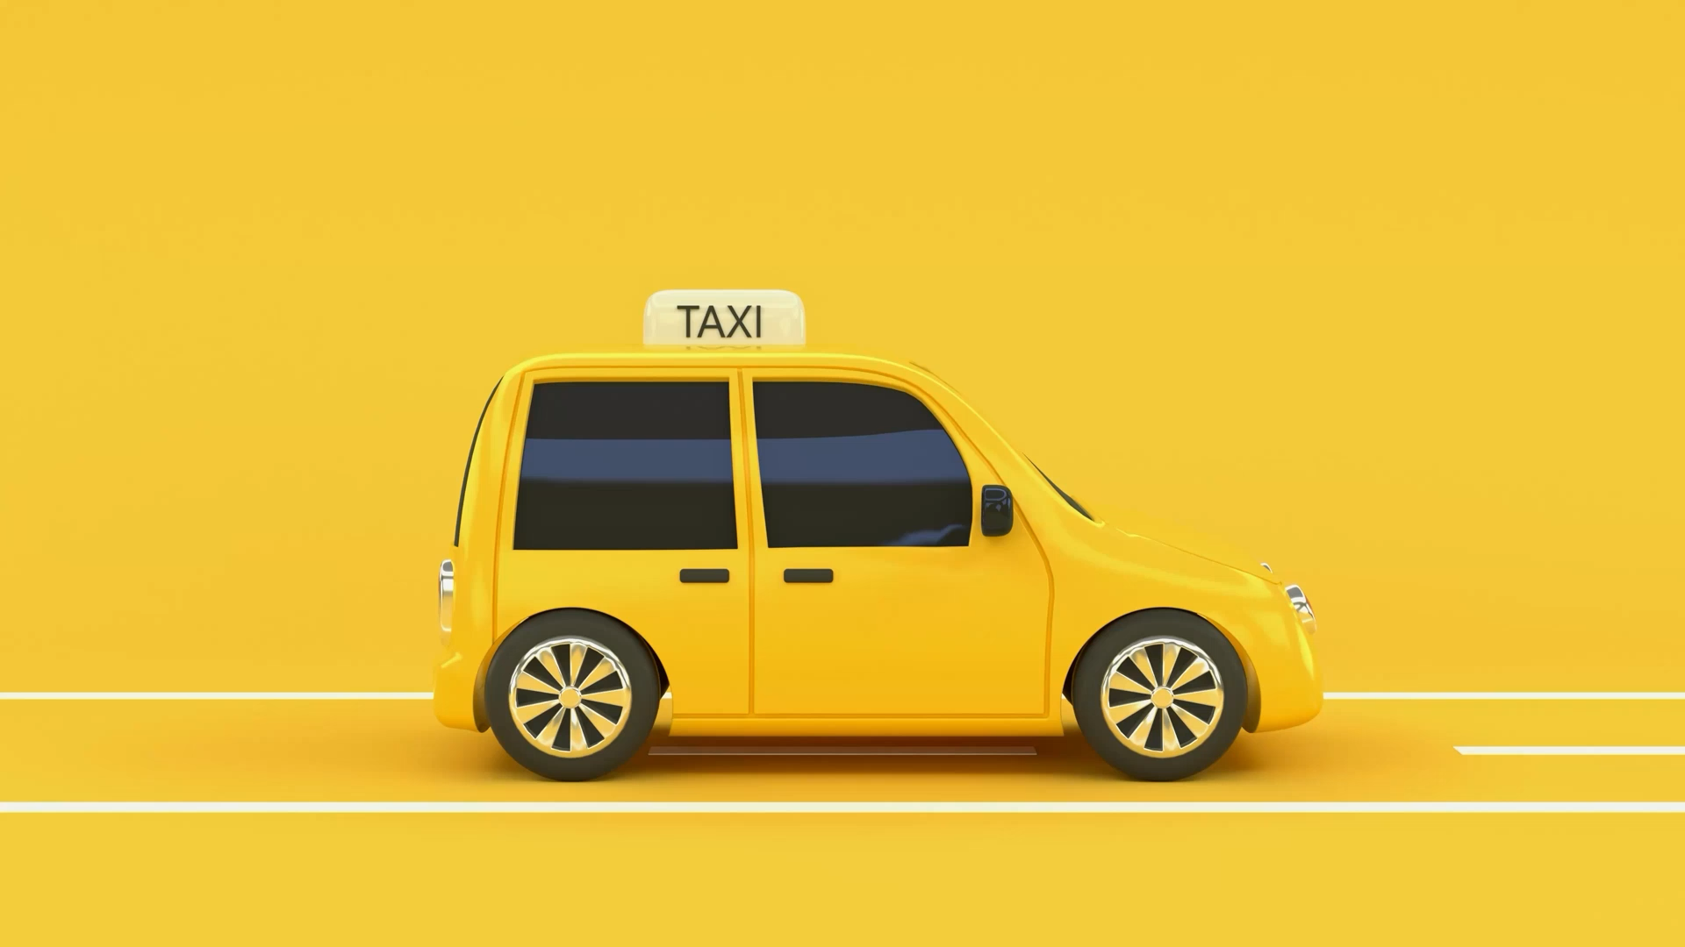
Prediction of taxi fares and driver behavior analysis
Pavan Kumar Duvvuru
U44710734
10/16/2023

Slide 2

Introduction & Objective
Project overview: This presentation explores the Behavior Analysis of Taxi Drivers with a focus on enhancing efficiency in the taxi service industry.
Background Information: In an era of data-driven decision-making, understanding driver behavior is crucial for improving service quality and profitability in the transportation sector.
Objective of the Analysis:
1. To gain insights into taxi driver behavior patterns, including earnings, trip frequency, and customer interactions, to inform strategies for improving service efficiency.
2. To identify anomalies and categorize drivers based on their performance, facilitating targeted interventions and enhancing the overall taxi service experience.

Slide 3
Description of data:
 | Attributes | Description
0 | medallion | an md5sum of the identifier of the taxi - vehicle bound (Taxi ID)
1 | hack license | an md5sum of the identifier for the taxi license (Driver ID)
2 | pickup datetime | time when the passenger(s) were picked up
3 | dropoff datetime | time when the passenger(s) were dropped off
4 | trip time in secs | duration of the trip
5 | trip distance trip | distance in miles
6 | pickup longitude | longitude coordinate of the pickup location
7 | pickup latitude | latitude coordinate of the pickup location
8 | dropoff longitude | longitude coordinate of the drop-off location
9 | dropoff latitude | latitude coordinate of the drop-off location
10 | payment type | the payment method -credit card or cash
11 | fare amount | fare amount in dollars
12 | surcharge | surcharge in dollars
13 | mta tax | tax in dollars
14 | tip amount | tip in dollars
15 | 15 tolls amount | bridge and tunnel tolls in dollars
16 | 6 total amount | total paid amount in dollars
The dataset used for this project comprises New York City Taxi trip reports from 2013, publicly accessible through the Freedom of Information Law (FOIL) and made available by Chris Whong.
Through Spark programs in Python, we aim to analyze this extensive dataset to gain valuable insights into taxi service operations and driver behavior.

Slide 4
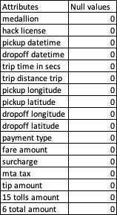
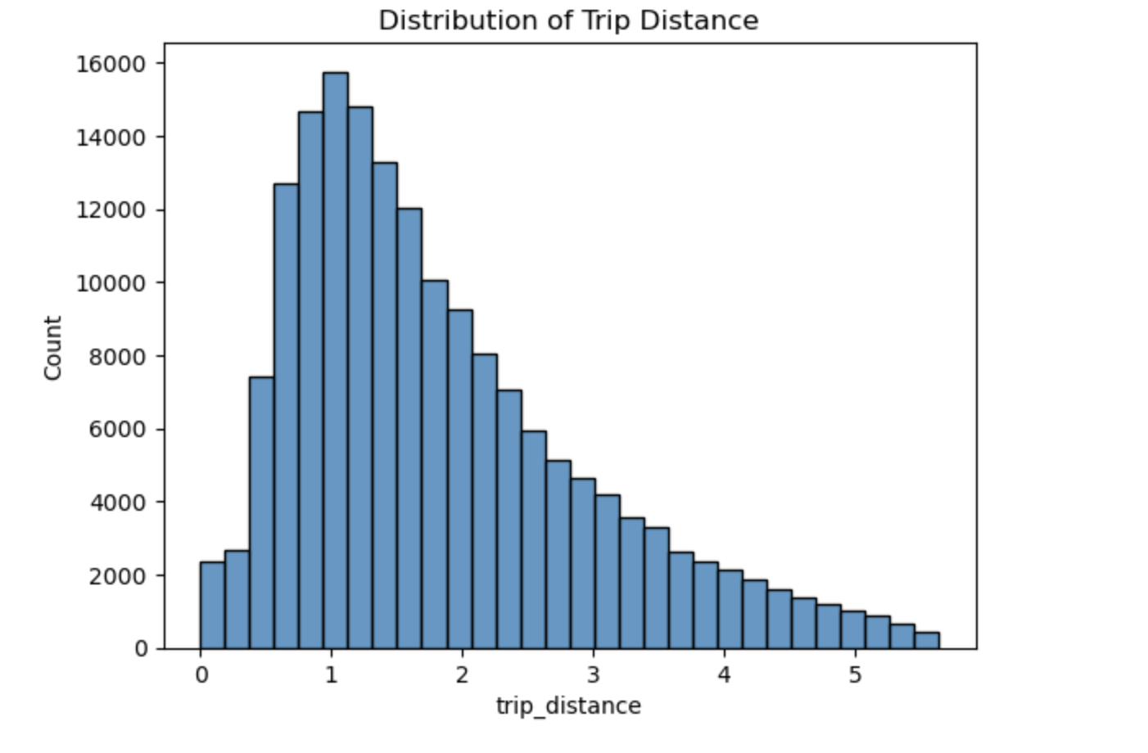
Exploratory Data Analysis (EDA):
Null Values Analysis::
1. Checked for missing values in all attributes.
2. Confirmed the absence of null values in essential attributes.
3. Ensured data integrity for subsequent analyses.
Distribution of Trips:
Visualized trip distance distribution.
Most trips were between 0.5 to 2.5 miles.
Bell-shaped distribution with slight right-skew.
Indicates shorter trips are more common.

Slide 5
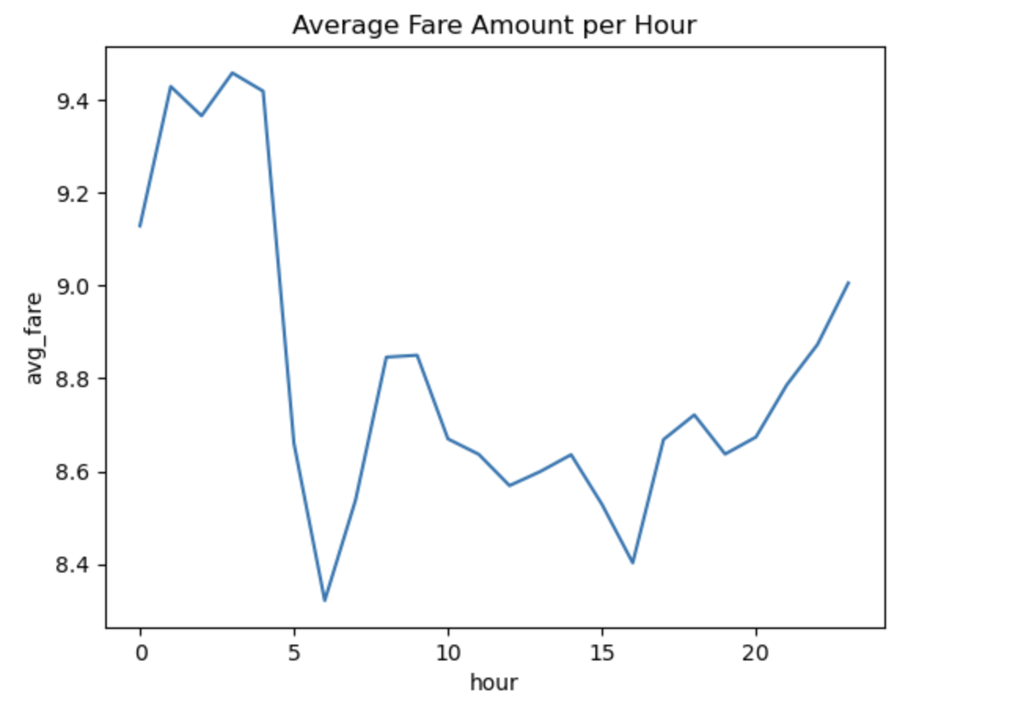
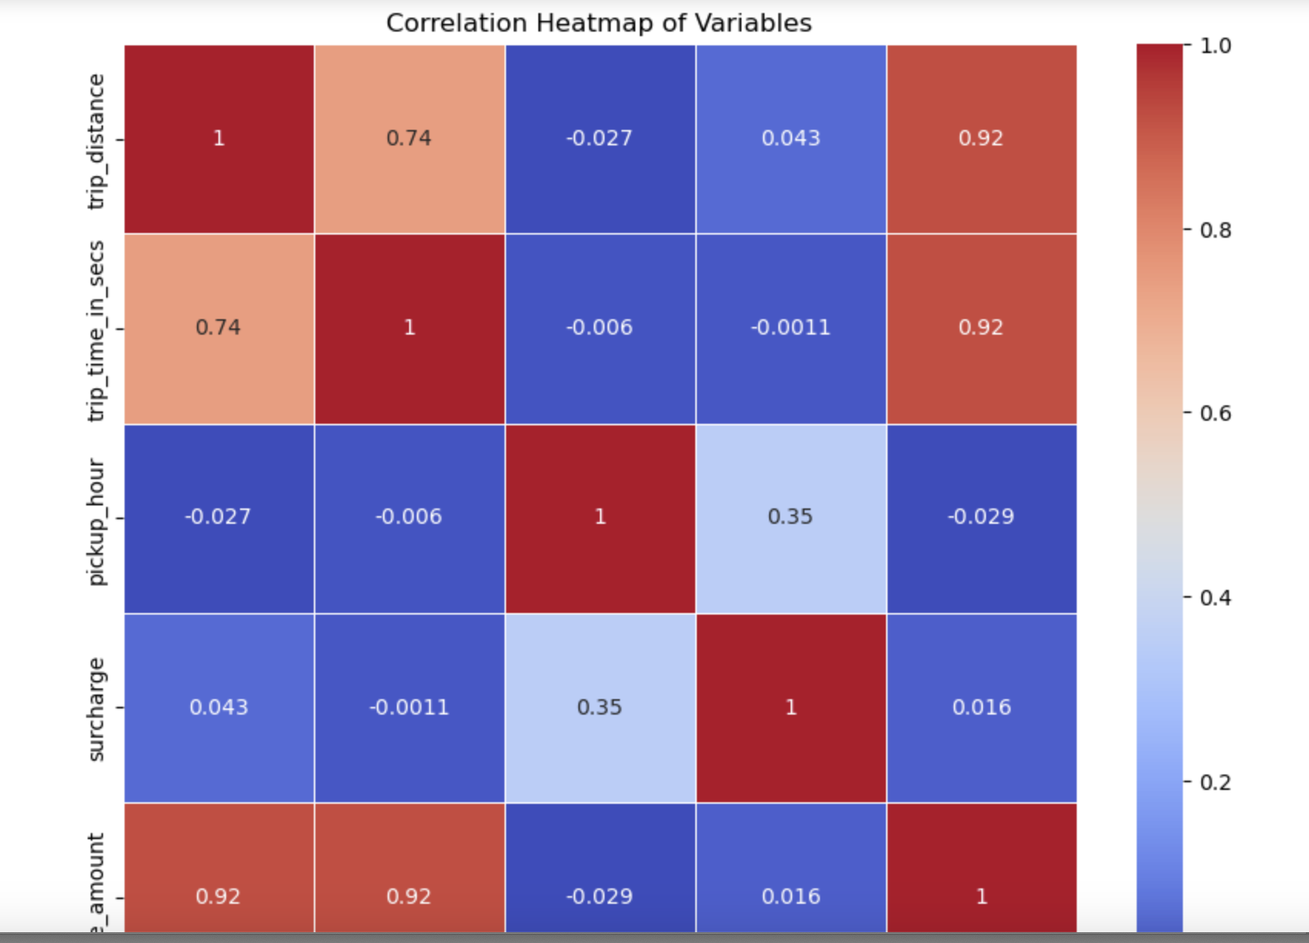
Exploratory Data Analysis (EDA):
Average Fare Amount Per-Hour:
1. Analyzed average fare trends throughout the day.
2. Highlighted peaks during morning and late evening.
3. Suggested pricing dynamics related to demand and availability.
Correlation Heatmap:
1. Explored correlations between variables.
2. Strong positive correlation between trip distance, trip time, and total amount
3. Minimal correlations between other variables.

Slide 6
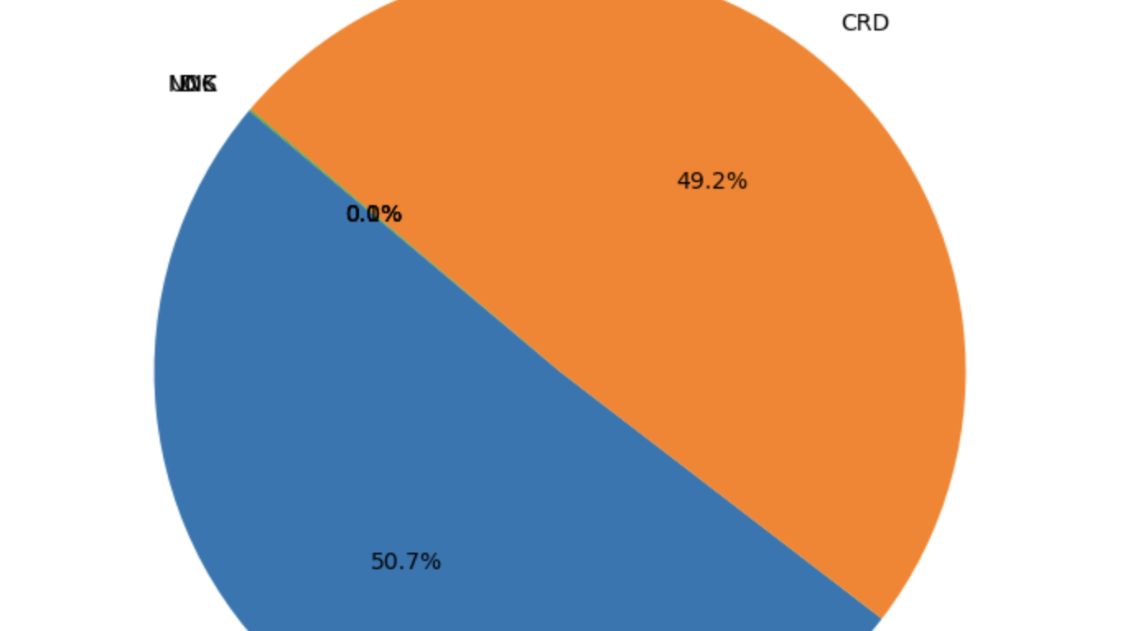
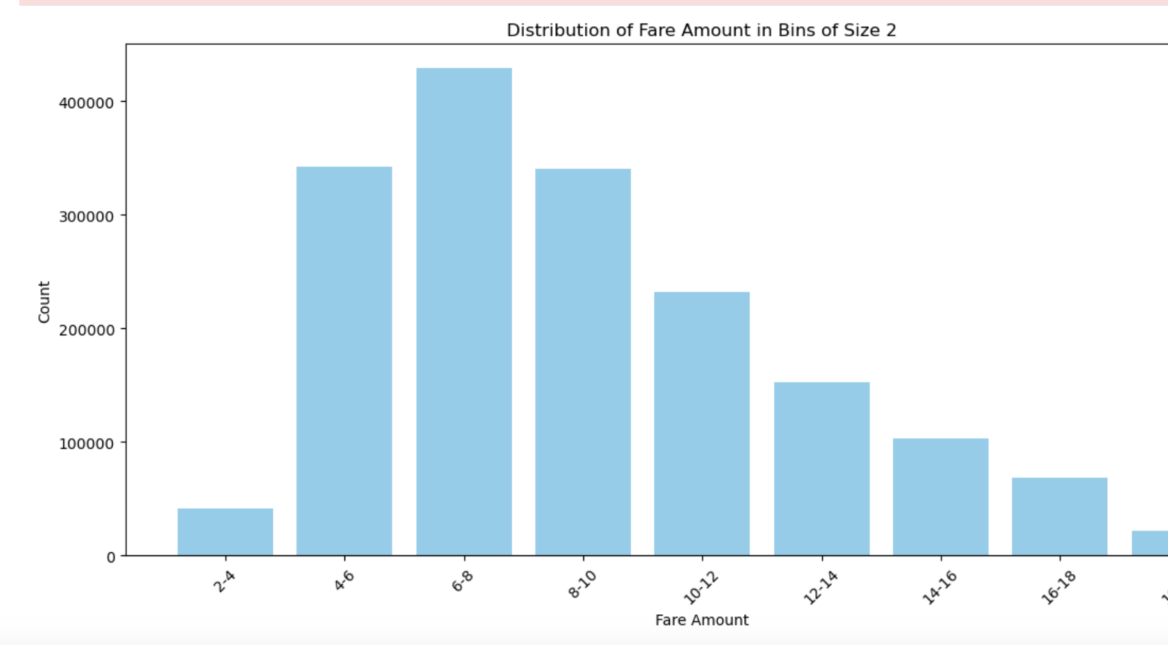
Exploratory Data Analysis (EDA):
Pie Chart of Payment Modes:
Displayed payment methods distribution.
50.7% use cash (CSH), 49.2% use card (CRD).
0.0% use another method (N/A).
Distribution of Fare Amount:
Presented the distribution of fare amounts.
Highlighted the range of fare values.

Slide 7
Machine learning model- LR
Objective:
Predict taxi fare amounts based on trip attributes and geospatial data.
Model Selection:
Linear Regression chosen for simplicity and interpretability.
Future scope for exploring advanced models.
Data Preparation:
Features combined into a unified vector.
Dataset split into training (80%) and testing (20%) sets.
Model Training:
Linear regression trained on the training dataset.
Model prepared for fare amount predictions.
Model Evaluation:
RMSE (Root Mean Squared Error) used to assess prediction accuracy.
Achieved RMSE: 1.3756.

Slide 8

Driver Behavior Analysis
Anomalies in Total Fare Earned:
Highlighted drivers with unusually high total fare earnings.
Investigated anomalies in terms of number of trips and average tip received.
These anomalies may indicate discrepancies or outliers in driver behavior.
Anomalies in Number of Trips:
Identified drivers with significantly high numbers of trips.
Explored anomalies in total fare earnings and average tip received for these drivers.
Detected outliers in driver activity.

Slide 9
Driver Behavior Analysis
Anomalies in Average Tip Received:
Examined drivers with exceptionally low or high average tip amounts.
Investigated their total fare earnings and number of trips.
Outliers in tip amounts may reflect diverse driver behavior.
Driver Behavior Insights:
High-earning drivers might be outliers due to various factors such as long trips or high-demand areas.
Drivers with a low number of trips may exhibit different behavior patterns.
Analysis provides a glimpse into driver behavior diversity within the dataset.

Slide 10

Future Scope & Conclusion
Future Scope:
Implement Real-time Monitoring Systems.
Utilize Machine Learning for Predictive Driver Behavior Analysis.
Enhance Driver Training Programs.
Refine Customer Satisfaction Strategies.
Optimize Taxi Service Industry's Efficiency & Customer Experience.
Conclusion:
Comprehensive Exploration of Taxi Driver Behavior.
Highlighted Variations in Total Fare Earnings, Trip Frequency, and Average Tips.
Emphasized the Importance of Tailored Incentives and Support for Driver Satisfaction and Productivity.
K-Means Clustering Categorized Drivers into Distinct Segments.
Lays the Groundwork for Implementing Real-time Monitoring and Machine Learning.
Opportunities to Improve the Taxi Industry for Greater Efficiency and Customer Satisfaction.

Slide 11

Thank you

